Slide 1
Studying Cosmic Reionization
Extragalactic Astrophysics and Cosmology Group Study
Seminar 12th March 2013

Slide 2
Extragalactic Astrophysics and Cosmology Group Study 2013
Predictions Group Seminar

Slide 3
Our Aims:
To be able to predict the number of galaxies present during the epoch of Cosmic Reionization.
To find the high redshift limit of this epoch through star formation rates.
To calculate the number of UV photons available to re-ionize the neutral hydrogen in the IGM in order to obtain an estimate for the lower redshift limit.

Slide 4
How we have done this:
Built a program to automate process of calculating number of galaxies using Schechter Function.
Found plausible starting parameters and determined their evolutions with time to incorporate into program.
Determined how cosmic variance affects the number of galaxies.
Plotted results to display data in a more ‘user friendly’ way.
Give an estimate of the number of galaxies to the observers.
Estimated the redshift range of Cosmic Reionization using star formation rates.

Slide 5
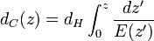
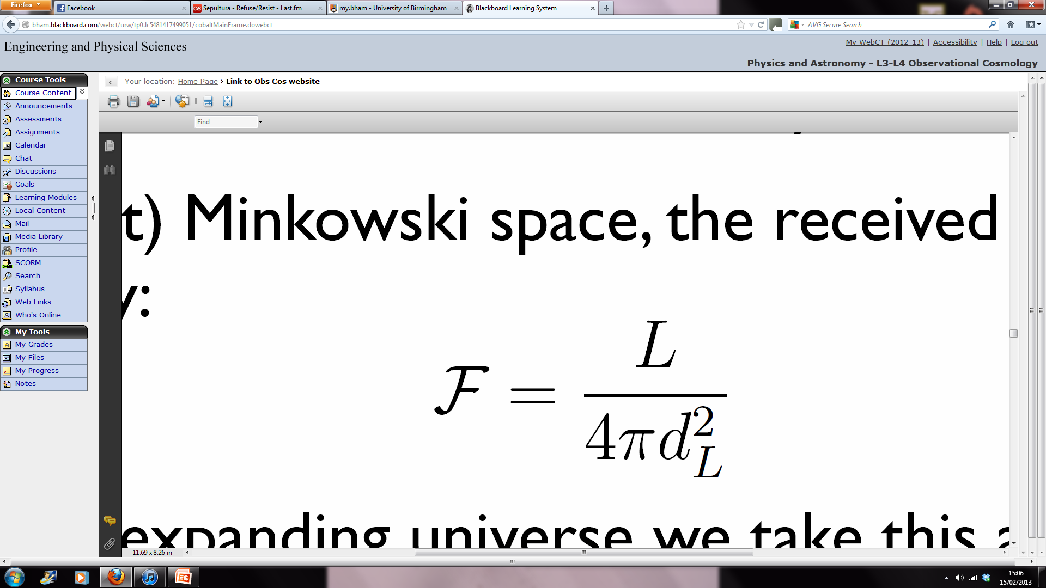
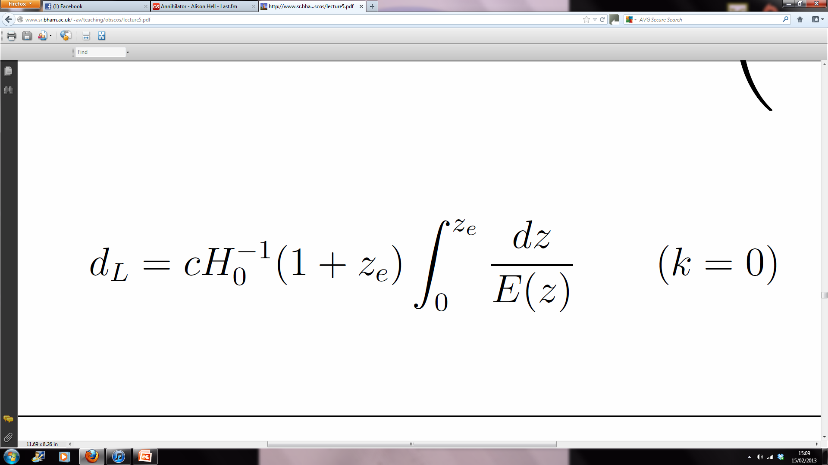
Cosmological Distances
Co-moving Distance
Luminosity Distance
Magnitude Conversion
Notes:
dH (hubble distance) radius of the visible universe. Luminosity distance is redshifted. Magnitude conversion is for AB system. Get volume from comoving volume.

Slide 6
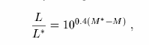
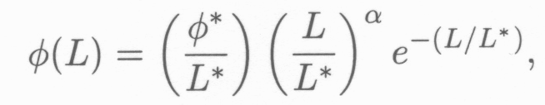
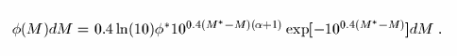
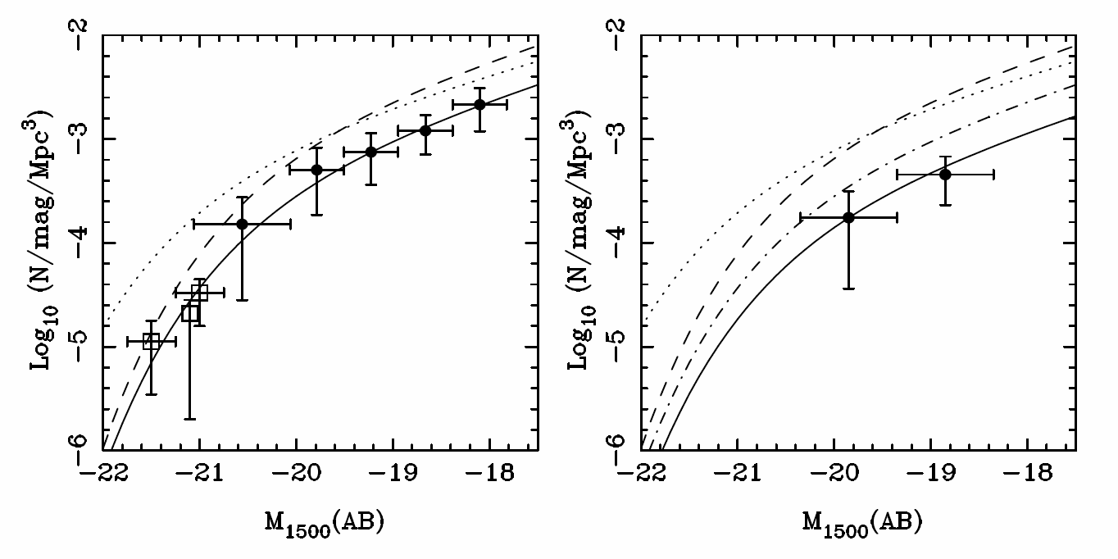
Schechter Function
Z=7
Z=8
(McLure, 2010)

Slide 7
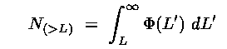
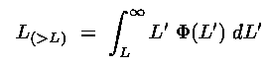
Schechter Function
Number Density:
Luminosity Density:

Slide 8
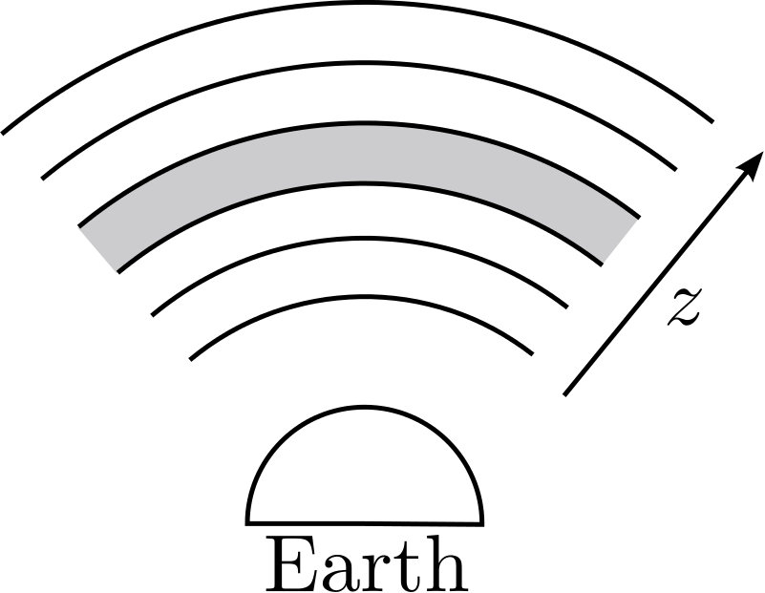
Assumptions
Universe is:
Flat
Matter Dominated
No cosmic variance
AB Magnitude system
Magnitude to Flux Density
Schechter Function
Parameters of the Schechter function do not change as a function of redshift.
Evolution is as predicted by data.

Slide 9
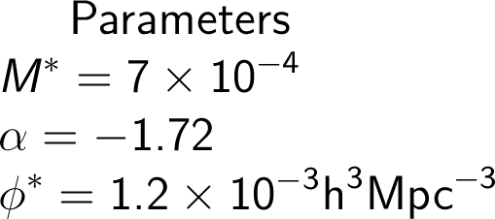
Parameters
Parameters taken from papers on high redshift galaxies.
Started with constant values, moved on to parameter evolution with redshift.
Characteristic Magnitude
Faint End Slope Gradient
Normalisation Factor

Slide 10
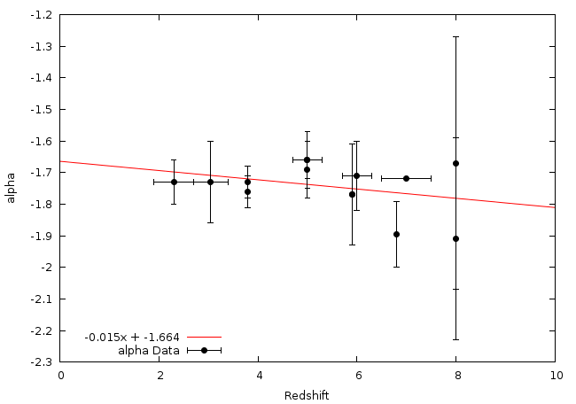
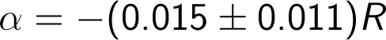
alpha Evolution - Linear

Slide 11
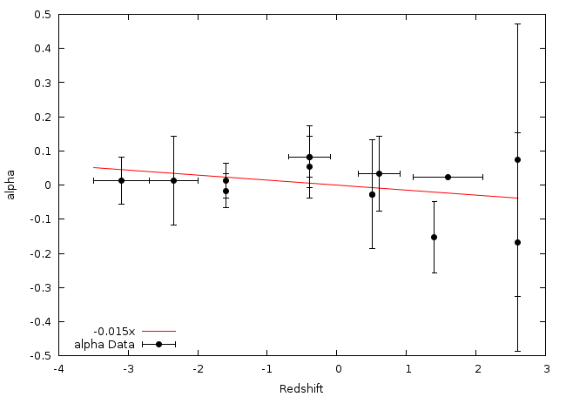
alpha Evolution - Pivot

Slide 12
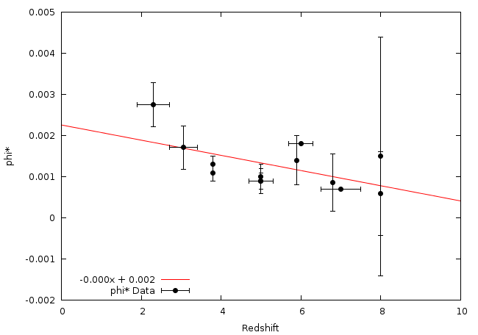
phi* Evolution - Linear

Slide 13
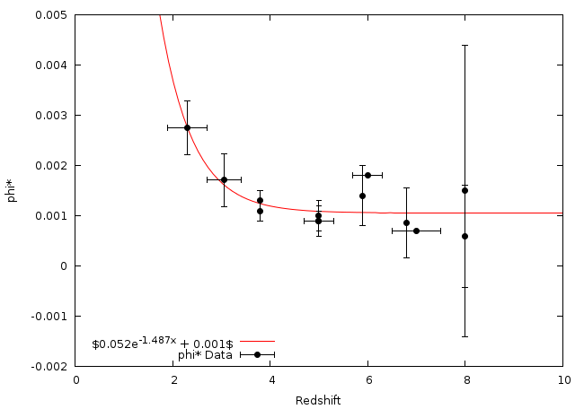
phi* Evolution - Exponential

Slide 14
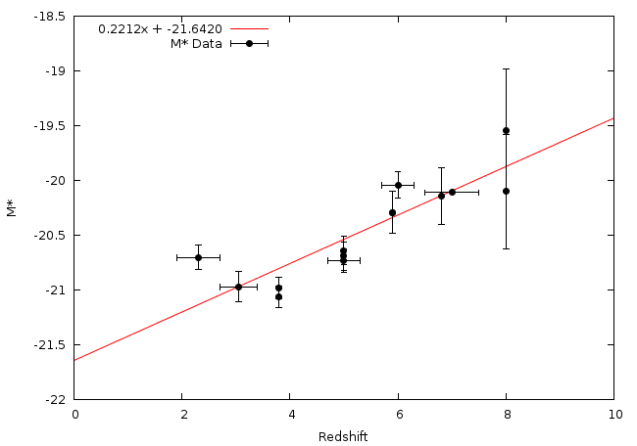
M* Evolution - Linear

Slide 15
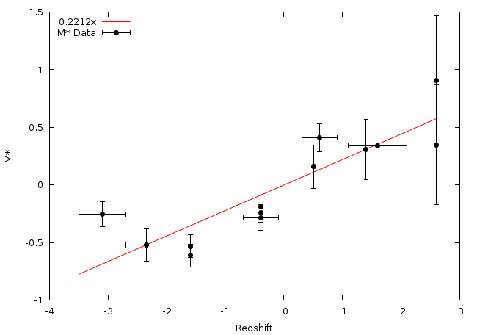
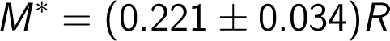
M* Evolution - Pivot

Slide 16
The Programs
We have created two programs designed to compute the same quantities in slightly different ways in order to validate any results we obtain.
These have been predominantly written by Owen and Andy.

Slide 17
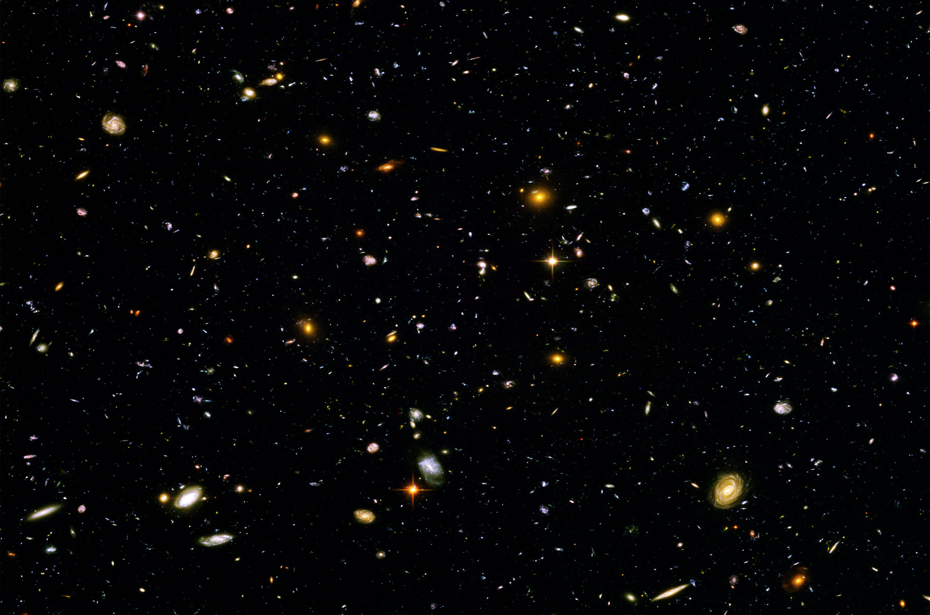
Finding the Number of Galaxies

Slide 18
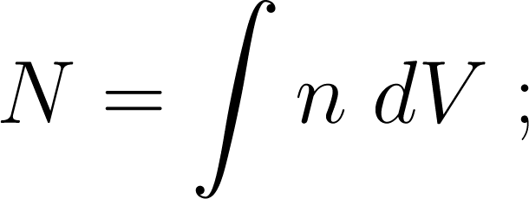
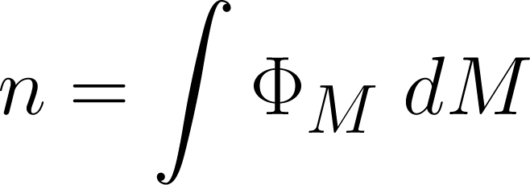
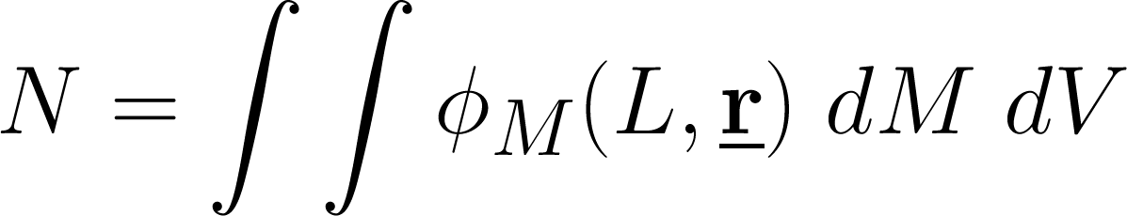
Method

Slide 19
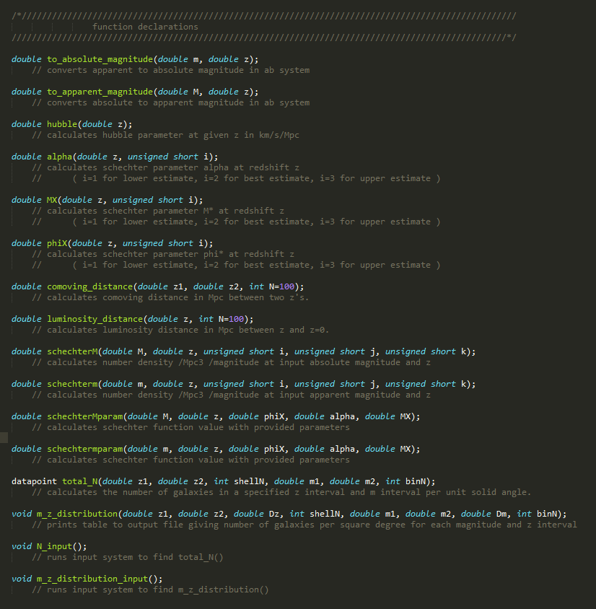
Code

Slide 20
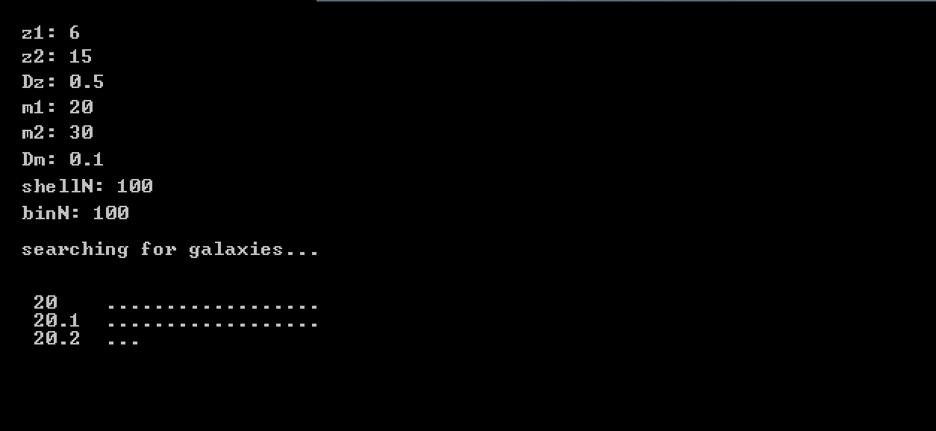
Input System
Simple input method
Limits are order independent
Loading bars to indicate progress

Slide 21
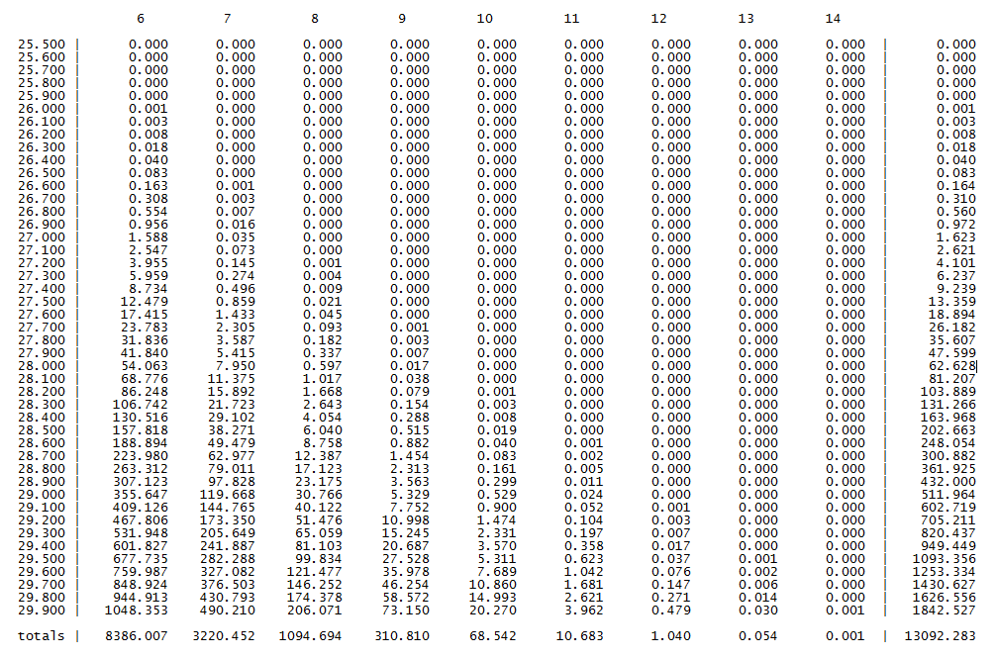
Output

Slide 34
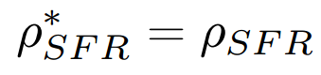
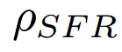
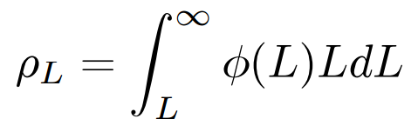
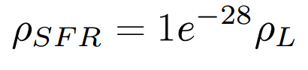
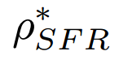
Calculating Higher Limit of Redshift
& Thereby Estimating Epoch of Reionization
Kennicutt (1998)
The z at which Reionization begins
is found from the luminosity density
is found from an analytical model

Slide 35
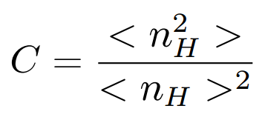
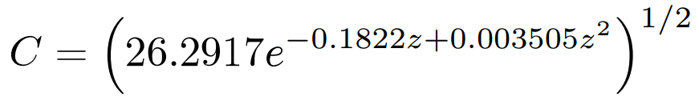
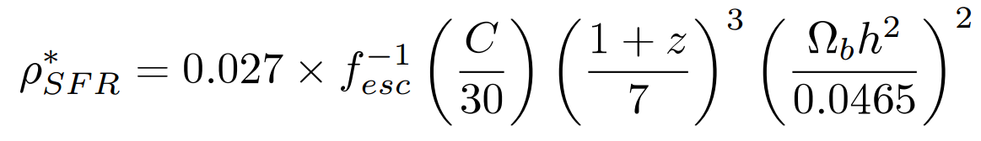
Critical Star Formation Rate Density
Recombination rate is proportional to clumping factor
Clumping Factor
Model
(Illev et al. 2007)
Critical Star Formation Rate Density relation
(Bagala et al. 2009)

Slide 36
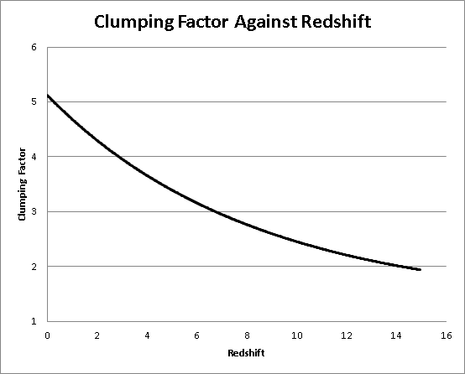

Slide 37
Star Formation Rate Density
Area under the schechter function is infinite unless L is specified
We need a lower luminosity limit
Lower Limit comes from lower mass → Jeans Mass

Slide 38
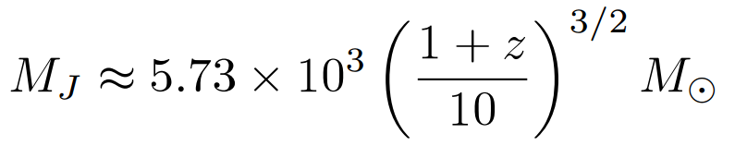

Minimum Luminosity
At z=106, MJ is approximately 1.1x10⁵
Using a M-L ratio of order unity
L≈1.1x10⁵ Solar Luminosity
Corresponds to Absolute Magnitude of -7.5

Slide 39
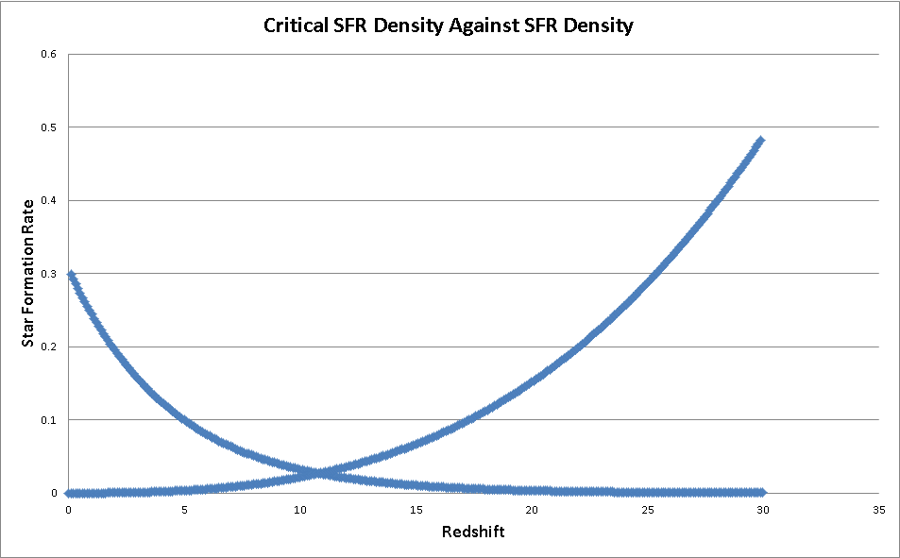
(Solar Masses per year per Megaparsec cubed)
Critical SFR Density
SFR Density

Slide 40
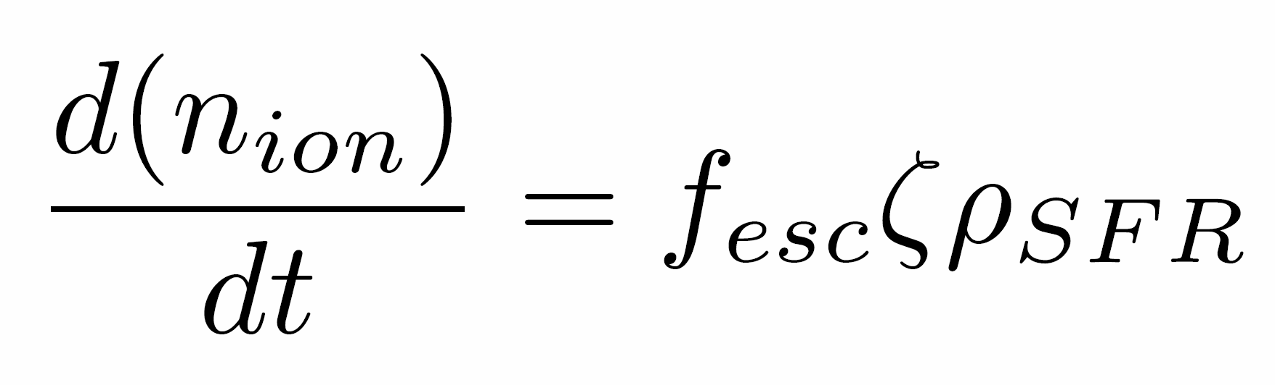
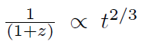
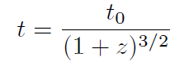
Lower redshift Limit of Reionization
Where assuming matter dominated epoch,

Slide 41
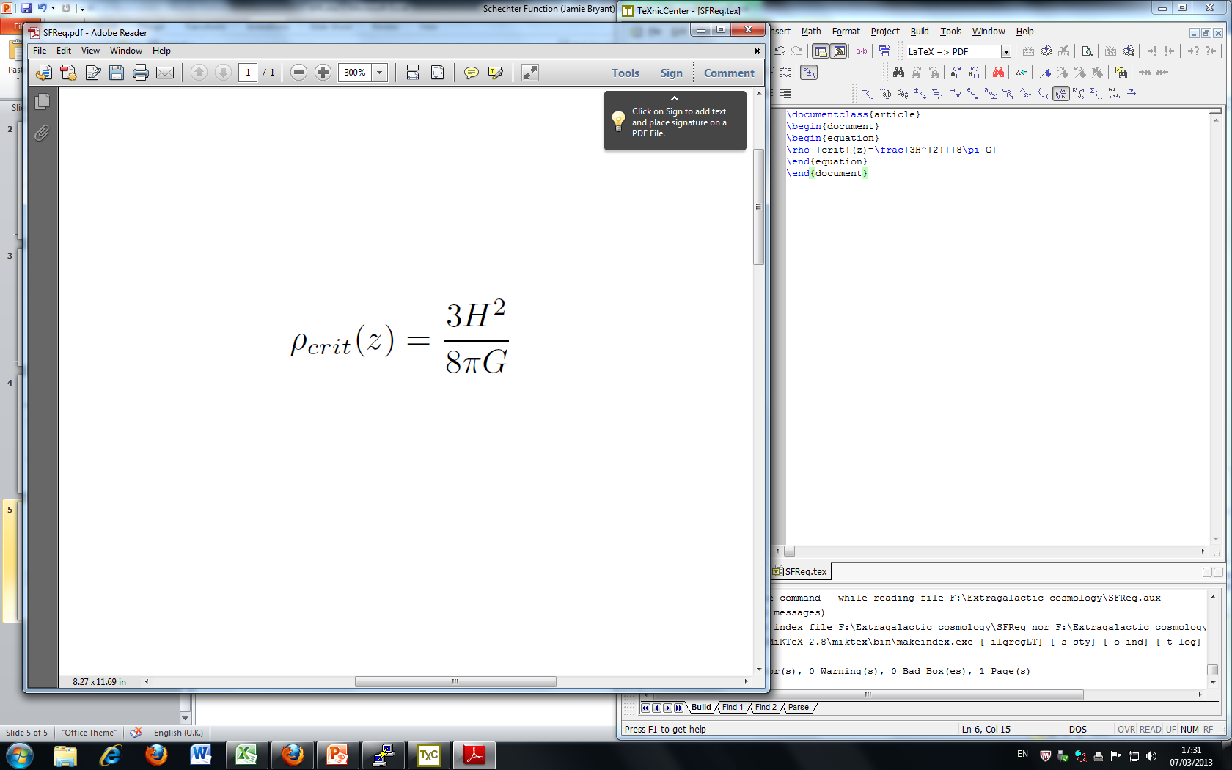
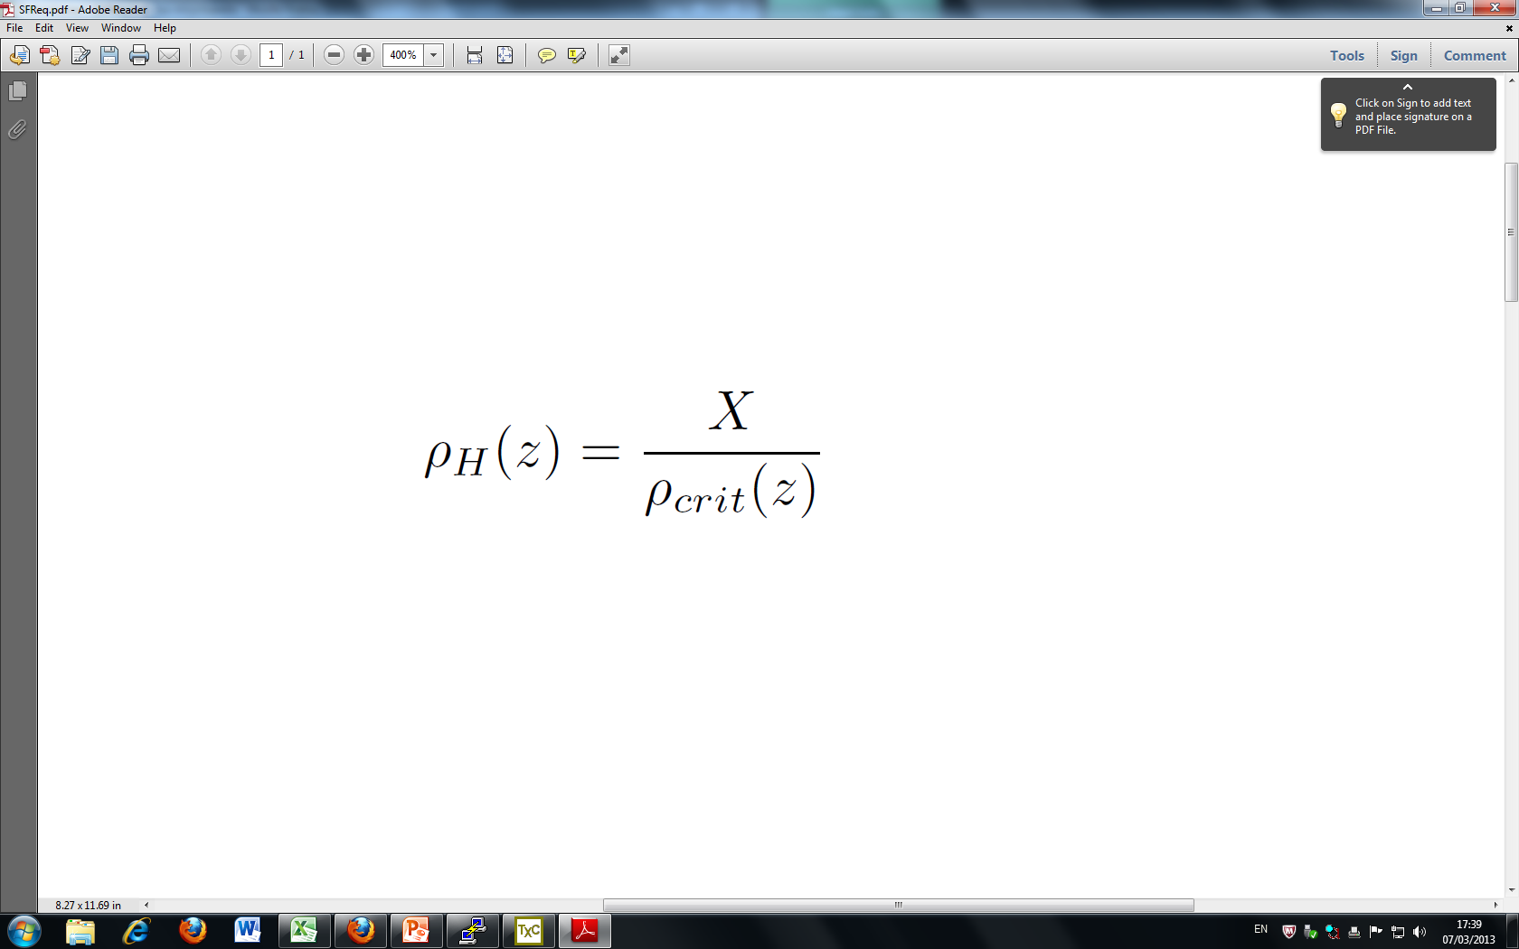
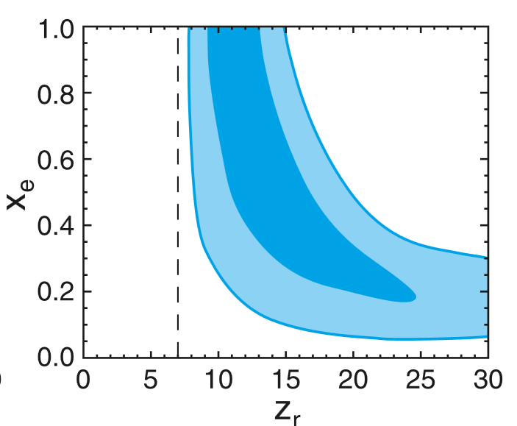
Lower redshift Limit of Reionization
Notes:
Taking primordial hydrogen fraction to be about 0.8064. fesc 0.2 and zeta 3e53. Get a 1 ionized fraction at about 6.5

Slide 42
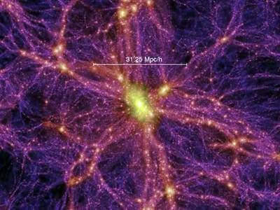
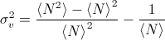
Cosmic Variance
Statistical uncertainty in any cosmological observation brought about by large-scale cosmic structure.
The Universe is only homogeneous at the largest scales (>1Gpc).
This will be the dominant source of error, well in excess of Poisson noise.
Any number or density measurement derived from a galaxy population is susceptible to Cosmic Variance.
Any cosmic survey should take account of Cosmic Variance.
Given by:

Slide 43
Including in the code
Any estimates produced for the observing team, from the code, should account for Cosmic Variance in some way.
The Cosmic Variance of a survey depends on:
Total survey volume.
Aspect ratio - lower for higher aspect ratio surveys.
Number of sightlines - empirically reduced with multiple sightlines, by √N – where N is the no. of sightlines.
We found an empirical formula for the Cosmic Variance for any galaxy survey, derived
using SDSS and extrapolated to higher redshifts.
Now, the program can give an estimate for Cosmic Variance for any survey the observers
choose to input. It also can give the appropriate number of random pointings or aspect
ratio necessary to reduce Cosmic Variance to below 10%.

Slide 44
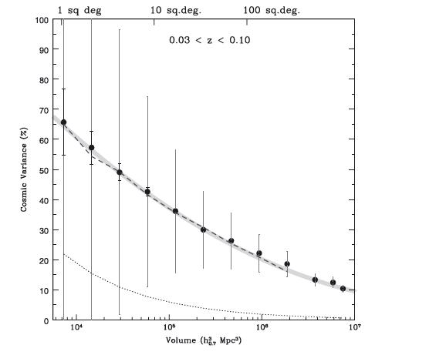
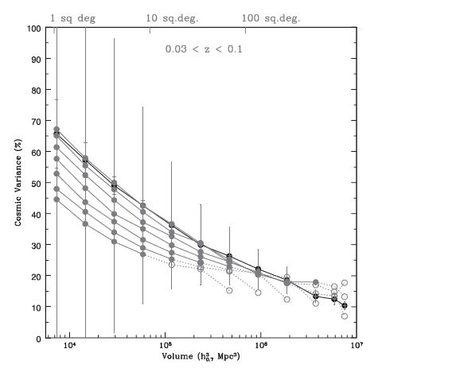

Slide 45
Summary:
We can calculate the number of galaxies in any specified magnitude and redshift range.
The appropriate number of sightlines to reduce the effect of cosmic variance to below 10% for a given telescope and survey size can be calculated.
Or similarly for the preferred aspect ratio.
Our current estimates expect that Cosmic Reionization began at a redshift of approximately z=11 and ended at approximately z=6.

Slide 46
Any Questions?

Slide 47
Observational Strategy Sub-Group
Extragalactic Astrophysics and Cosmology Group Study 2013
Michael O’Neill, Joe Baumber, Catherine McDonald, Dorothy Stonell, Rahim Topadar, John Shepley

Slide 48
Introduction
Group Aims
Methods for Study
Colour
Gravitational Lensing
Wide Survey
Deep Survey
Spectroscopy

Slide 49
Observing Strategy Aims
To formulate an observing strategy capable of observing the EoR.
Focus:
Observing the high-z beginning of the EoR to further the understanding of structure formation.
Taking advantage of future advancements.
Creating a strategy able optimised to reduce the observation time required.

Slide 50
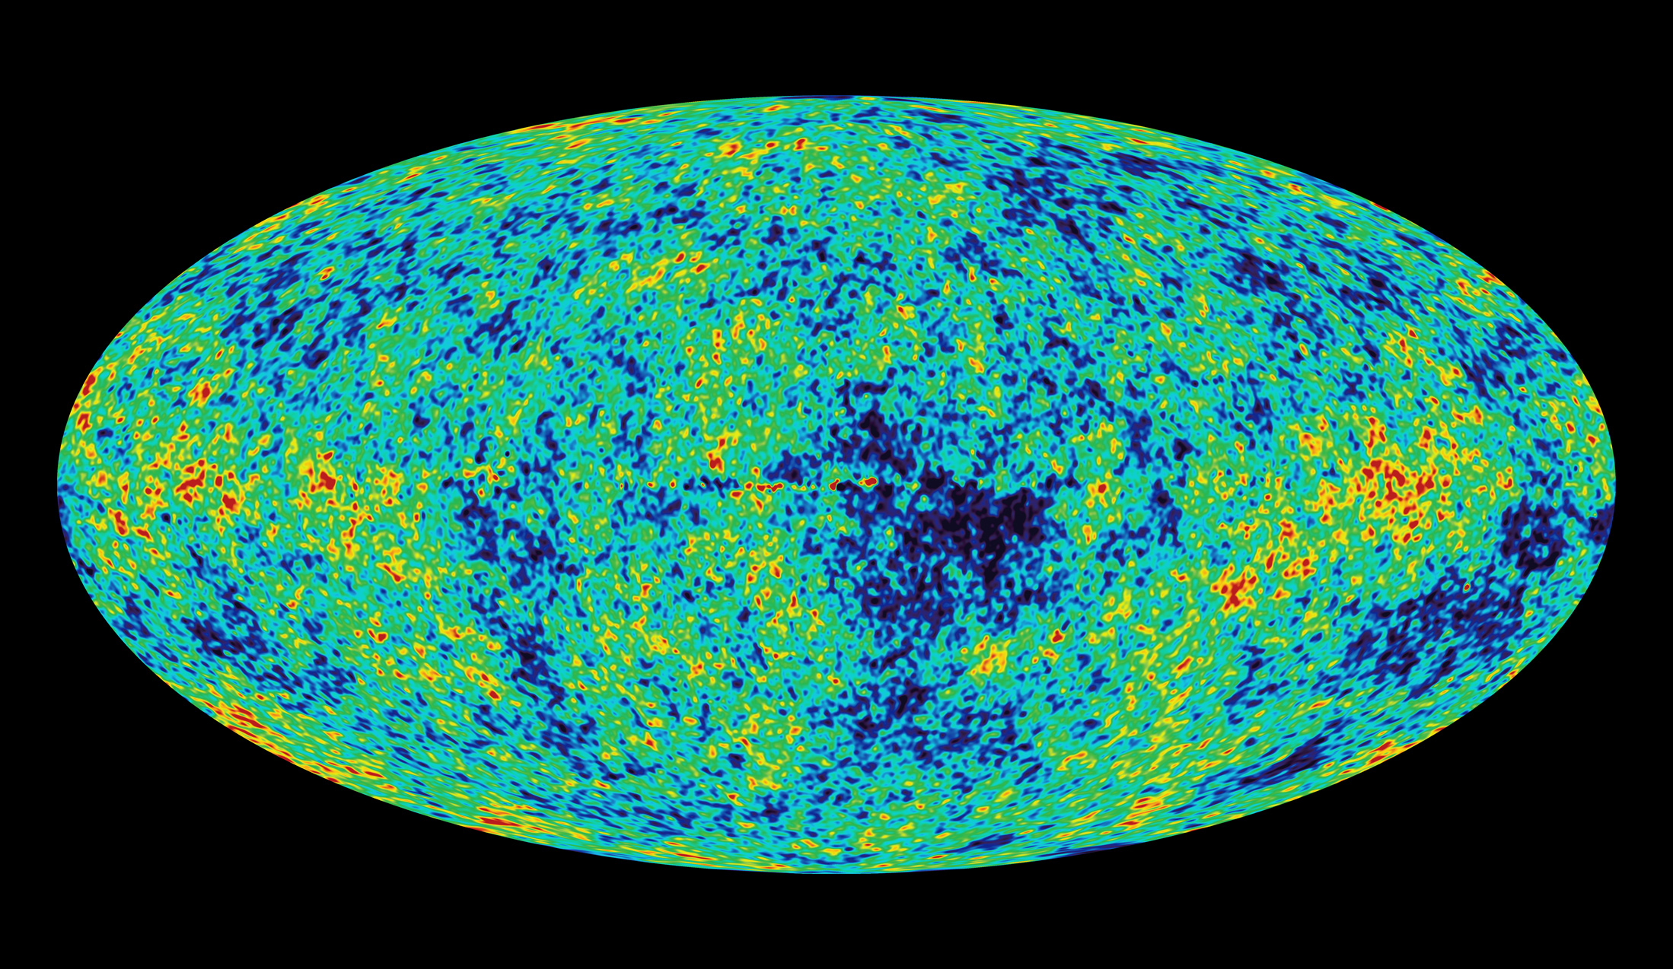
Methods for Study
CMB anisotropy
21 cm line
Dropout method
CMB anisotropy
Notes:
After CMB released, photons encountered observable Thomson scattering off of free electrons leaving secondary anisotropies on the CMB map. By comparing observations with models of how universe would appear without Reionization having happened measurements of the electron column density can be made. From this it is possible to calculate the period over which EoR occured.

Slide 51
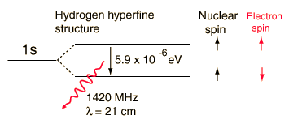
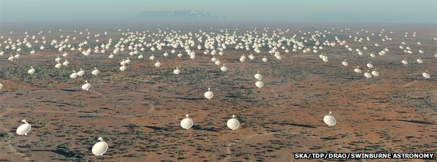
21 cm line
Notes:
21cm – emission line from hyperfine transition between Hydrogen 1s ground state. Ionized hydrogen will appear as holes in the 21cm background.
Observed using radio arrays such as the planned SKA across Australia and Africa. Can be used to provide very accurate picture of the Hydrogen makeup of the Universe following recombination.
Lots of interference from all the radio transmissions we use day to day, located in secluded areas. Proposals for projects operating on the dark side of the moon have been made to compensate. Seen to be the next generation of Observational cosmology but still some way off at present.

Slide 52

Lyman-Break Galaxies
(Dropout Method)
Notes:
Photometry techniques – Taking images of the first star-forming galaxies in 3 different filters. We choose these filters so we expect to see flux in 2 bands and an absence of flux in one. This absence in flux is due to the photons being blue-ward of the Lyman-limit and are able to ionise netural hydrogen, i.e. They got lost on their way to us. Many proposed telescopes on their way; JWST, Euclid, E-ELT which will be able to see further back than ever before with vastly improved accuracy.

Slide 53

What is Colour?

Slide 54
Colour for Lyman-break galaxies
Defined as difference in magnitudes between filters
For Lyman-break galaxies, there will be a large decrease in magnitude for a band situated on the break and blue-ward of the break, due to the absorption of the flux by the Gunn-Peterson effect.
But what about Contaminants?

Slide 55
Contaminants
Photometric scatter, interlopers, (brown dwarf stars, galaxies at intermediate redshift)
To eliminate the contaminants, restrictions can be placed upon the data using another filter red-ward of the filter containing the drop
From these two colour values for each object observed, a colour-colour diagram can be made with a colour window for our target objects, eliminating most contaminants

Slide 56
Telescope filters chosen
J-W F200w Wavelength (microns) | Calculated Redshift of Lyman Break
1.61 | 12.26
1.71 | 13.09
1.81 | 13.92
1.92 | 14.75
2.02 | 15.58
2.12 | 16.40
2.22 | 17.23
2.32 | 18.06
2.42 | 18.89
2.52 | 19.72
Hubble
F105w, F125w, F160w
Can provide colour-colour diagrams for approximately z= 7.9-10
James-Webb
Able to do three band photometry for the galaxies across all redshift ranges, but will most likely be used for z>10, possibly for some range within z= 5-8
F070w, F090w F115w, F150w, F200w, F277w
E-ELT
Doesn’t have correct filters for colour selection for z= 10-15
Euclid
Y,J,H filters
Colour information only for approximately z=8.4-10

Slide 57
Using the Program Hyperz
Can create a catalog of synthetic lyman-break galaxies in a particular redshift range
gives magnitude in a certain filter using transmission files using a reference filter with a certain magnitude, with a sample spectrum
Colour-colour diagram can be formed to show statistical grouping of galaxies, so a colour window can be found

Slide 58
Make_catalog
Reference filter chosen for a redshift range. Must contain observed red-shifted wavelength of the rest frame 1500A wavelength over the redshift range
Magnitude can be obtained from Predictions group from observed luminosity function of 1500A
Program then uses a sample spectrum to convert this magnitude to what it would be in other bands

Slide 59

Vega Spectral Energy Distribution
Choose filters from database
Spectrum of lyman-break
Output files
Reference filter and magnitude
Number of galaxies
Redshift all galaxies were formed
Redshift range
Age of galaxies
Extinction
Cosmological parameters

Slide 60
Other Factors
Forming Redshift
Age of galaxies
Reddening law
Cosmological Parameters

Slide 61
An ‘example’ Colour-Colour diagram
Hubble z=6-8 (incorrect)

Slide 62
Aims for next couple of weeks
Find reference filters for the range of redshifts required
Produce more accurate red-shift ranges for filters
Convert magnitudes to AB from Vega
Look into the Reddening law
Produce colour-colour diagrams for redshifts 6-15

Slide 63
Gravitational Lensing

Slide 64

Gravitational Lensing
Magnification of distant sources
Einstein ring if perfect alignment
More likely to observe 2 arcs centred on lens
Azimuthal angle of images constant

Slide 65


Option 1: Locate New Lenses
Select using strong lensing
Specific selection criteria
Area of sky
Away from bright contaminants
Compatible with telescopes
Redshift range
Shear (shape distortion) is greater at higher lens redshifts
Einstein angle greater at lower lens redshifts
Optimum around z=0.6

Slide 66

Option 2: Known Lenses
Limited number known ~50
Known mass, velocity dispersion and radius
Cluster Lensing And Supernova survey with Hubble (CLASH)
25 x-ray selected clusters
Found a lensed candidate z=11.9 galaxy
MAssive Cluster Survey (MACS)
On-going survey
So far >100 spectroscopically confirmed clusters at 0.3 ≤ z ≤ 0.7
Reduces observing time

Slide 67
Gravitational Lensing Summary
Trade off between viewing area and source magnification
Choose known lenses
Use lensing to supplement deep survey

Slide 68


The Deep Survey

Slide 69
Deep survey
Will be able to view high redshift galaxies
Look more closely at candidates
Confirm by detecting in multiple bands

Slide 70



E-ELT
JWST
VS
Adaptive optics

Slide 71

Calculating Observation Times
Euclid | Photons |  | 0.13 | 0.02
 | a |  | 0.02 | 0.00
 | b |  | -355.45 | -343.91
 | c |  | -929710.36 | -929710.36
 | Time (Seconds) |  | 22529.38 | 1152557.36
 | Time (Hours) |  | 6.26 | 320.15
 | # of Exposures |  | 1.84E-02 | 1.52E-01
E-ELT | Photons |  | 52.32 | 6.82
 | Time (Seconds) |  | 19165.65 | 1128378.67
 | Time (hours) |  | 5.32 | 313.44
 | # of Exposures |  | 36.82 | 1775.80
JWST | Filter |  | 0.151 | 0.5
 | Photons |  | 0.81 | 0.35
 | a |  | 0.66 | 0.12
 | b |  | -786.13 | -739.92
 | c |  | -3064501.29 | -3064501.29
 | Time (seconds) |  | 2828.61 | 8830.70
 | Time (Hours) |  | 0.79 | 2.45
Overheads: Readout Time
Transmission
Cosmic Rays
Changing Filters

Slide 72
Combining the Programs to devise a deep survey strategy
(a last minute change!)

Slide 73
Making the best use of the Program
Output: a number density
How to get from that to a telescope?
Split up z and mag
Constrain the time – 3 bands, HUDF
Rahim’s program tells us the magnitude
Is it better to do one very deep survey or many shallower ones over a greater area?

Slide 74
The steps
Split this time up:
Example: 0.7 mil secs
No. of pointings | Fraction of total time | Time (million seconds)
1 | 1 | 0.7
2 | ½ | 0.35
3 | 1/3 | 0.23
4 | ¼ | 0.175

Slide 75
Group Studies - Observing Time Calculations
 | m |  | 28 | 29.1
 | z |  | 9.69 | 13
 | λ(obs) |  | 1.60E-06 | 2.10E-06
 | ν |  | 1.87E+14 | 1.43E+14
 | Energy |  | 1.24E-19 | 9.47E-20
 | Photons per joule |  | 8.06E+18 | 1.06E+19
 | Fν |  | 2.29E-31 | 8.32E-32
 | Fλ |  | 2.67E-24 | 5.66E-25
VLT | Photons |  | 2.28 | 0.63
 | Time (seconds) |  | 2752032.70 | 35805871.61
 | Time (hours) |  | 764.45 | 9946.08
 | # of Exposures |  | 4235.70 | 54659.71
Euclid | Photons |  | 0.13 | 0.04
 | a |  | 0.02 | 0.00
 | b |  | -355.45 | -345.86
 | c |  | -929710.36 | -929710.36
 | Time (Seconds) |  | 22529.38 | 258206.52
 | Time (Hours) |  | 6.26 | 71.72
 | # of Exposures |  | 1.84E-02 | 6.39E-02
E-ELT | Photons |  | 52.32 | 14.50
 | Time (Seconds) |  | 19165.65 | 249358.53
 | Time (hours) |  | 5.32 | 69.27
 | # of Exposures |  | 36.82 | 407.05
JWST | Filter |  | 0.151 | 0.21
 | Photons |  | 0.81 | 0.31
 | a |  | 0.66 | 0.10
 | b |  | -786.13 | -736.18
 | c |  | -3064501.29 | -3064501.29
 | Time (seconds) |  | 2828.61 | 1.05E+04
 | Time (Hours) |  | 0.79 | 2.91

Slide 76
The steps (continued)
 |  | 6 | 6.5 | 7 | 7.5 | 8 | 8.5 | 9 | 9.5 | 10 | 10.5 | 11 | 11.5 | 12 | 12.5 | 13 | 13.5 | 14 | 14.5 | 15 | 15.5
25 |  | 0 | 0 | 0 | 0 | 0 | 0 | 0 | 0 | 0 | 0 | 0 | 0 | 0 | 0 | 0 | 0 | 0 | 0 | 0 | 0 |  | 0
25.1 |  | 0 | 0 | 0 | 0 | 0 | 0 | 0 | 0 | 0 | 0 | 0 | 0 | 0 | 0 | 0 | 0 | 0 | 0 | 0 | 0 |  | 0
25.2 |  | 0 | 0 | 0 | 0 | 0 | 0 | 0 | 0 | 0 | 0 | 0 | 0 | 0 | 0 | 0 | 0 | 0 | 0 | 0 | 0 |  | 0
25.3 |  | 0 | 0 | 0 | 0 | 0 | 0 | 0 | 0 | 0 | 0 | 0 | 0 | 0 | 0 | 0 | 0 | 0 | 0 | 0 | 0 |  | 0
25.4 |  | 0 | 0 | 0 | 0 | 0 | 0 | 0 | 0 | 0 | 0 | 0 | 0 | 0 | 0 | 0 | 0 | 0 | 0 | 0 | 0 |  | 0
25.5 |  | 0 | 0 | 0 | 0 | 0 | 0 | 0 | 0 | 0 | 0 | 0 | 0 | 0 | 0 | 0 | 0 | 0 | 0 | 0 | 0 |  | 0
25.6 |  | 0 | 0 | 0 | 0 | 0 | 0 | 0 | 0 | 0 | 0 | 0 | 0 | 0 | 0 | 0 | 0 | 0 | 0 | 0 | 0 |  | 0
25.7 |  | 0 | 0 | 0 | 0 | 0 | 0 | 0 | 0 | 0 | 0 | 0 | 0 | 0 | 0 | 0 | 0 | 0 | 0 | 0 | 0 |  | 0
25.8 |  | 0 | 0 | 0 | 0 | 0 | 0 | 0 | 0 | 0 | 0 | 0 | 0 | 0 | 0 | 0 | 0 | 0 | 0 | 0 | 0 |  | 0
25.9 |  | 0 | 0 | 0 | 0 | 0 | 0 | 0 | 0 | 0 | 0 | 0 | 0 | 0 | 0 | 0 | 0 | 0 | 0 | 0 | 0 |  | 0
26 |  | 0.001 | 0 | 0 | 0 | 0 | 0 | 0 | 0 | 0 | 0 | 0 | 0 | 0 | 0 | 0 | 0 | 0 | 0 | 0 | 0 |  | 0.001
26.1 |  | 0.003 | 0 | 0 | 0 | 0 | 0 | 0 | 0 | 0 | 0 | 0 | 0 | 0 | 0 | 0 | 0 | 0 | 0 | 0 | 0 |  | 0.003
26.2 |  | 0.008 | 0 | 0 | 0 | 0 | 0 | 0 | 0 | 0 | 0 | 0 | 0 | 0 | 0 | 0 | 0 | 0 | 0 | 0 | 0 |  | 0.008
26.3 |  | 0.018 | 0.001 | 0 | 0 | 0 | 0 | 0 | 0 | 0 | 0 | 0 | 0 | 0 | 0 | 0 | 0 | 0 | 0 | 0 | 0 |  | 0.019
26.4 |  | 0.039 | 0.003 | 0 | 0 | 0 | 0 | 0 | 0 | 0 | 0 | 0 | 0 | 0 | 0 | 0 | 0 | 0 | 0 | 0 | 0 |  | 0.042
26.5 |  | 0.079 | 0.006 | 0 | 0 | 0 | 0 | 0 | 0 | 0 | 0 | 0 | 0 | 0 | 0 | 0 | 0 | 0 | 0 | 0 | 0 |  | 0.085
26.6 |  | 0.152 | 0.015 | 0.001 | 0 | 0 | 0 | 0 | 0 | 0 | 0 | 0 | 0 | 0 | 0 | 0 | 0 | 0 | 0 | 0 | 0 |  | 0.168
26.7 |  | 0.279 | 0.033 | 0.003 | 0 | 0 | 0 | 0 | 0 | 0 | 0 | 0 | 0 | 0 | 0 | 0 | 0 | 0 | 0 | 0 | 0 |  | 0.315
26.8 |  | 0.489 | 0.067 | 0.006 | 0 | 0 | 0 | 0 | 0 | 0 | 0 | 0 | 0 | 0 | 0 | 0 | 0 | 0 | 0 | 0 | 0 |  | 0.562
26.9 |  | 0.823 | 0.13 | 0.014 | 0.001 | 0 | 0 | 0 | 0 | 0 | 0 | 0 | 0 | 0 | 0 | 0 | 0 | 0 | 0 | 0 | 0 |  | 0.968
27 |  | 1.333 | 0.239 | 0.031 | 0.003 | 0 | 0 | 0 | 0 | 0 | 0 | 0 | 0 | 0 | 0 | 0 | 0 | 0 | 0 | 0 | 0 |  | 1.606
27.1 |  | 2.084 | 0.42 | 0.063 | 0.007 | 0 | 0 | 0 | 0 | 0 | 0 | 0 | 0 | 0 | 0 | 0 | 0 | 0 | 0 | 0 | 0 |  | 2.574
27.2 |  | 3.153 | 0.708 | 0.122 | 0.015 | 0.001 | 0 | 0 | 0 | 0 | 0 | 0 | 0 | 0 | 0 | 0 | 0 | 0 | 0 | 0 | 0 |  | 3.999
27.3 |  | 4.632 | 1.149 | 0.224 | 0.033 | 0.003 | 0 | 0 | 0 | 0 | 0 | 0 | 0 | 0 | 0 | 0 | 0 | 0 | 0 | 0 | 0 |  | 6.041
27.4 |  | 6.623 | 1.798 | 0.391 | 0.065 | 0.008 | 0.001 | 0 | 0 | 0 | 0 | 0 | 0 | 0 | 0 | 0 | 0 | 0 | 0 | 0 | 0 |  | 8.886
27.5 |  | 9.236 | 2.725 | 0.657 | 0.124 | 0.018 | 0.002 | 0 | 0 | 0 | 0 | 0 | 0 | 0 | 0 | 0 | 0 | 0 | 0 | 0 | 0 |  | 12.762
27.6 |  | 12.591 | 4.009 | 1.062 | 0.226 | 0.037 | 0.004 | 0 | 0 | 0 | 0 | 0 | 0 | 0 | 0 | 0 | 0 | 0 | 0 | 0 | 0 |  | 17.929
27.7 |  | 16.811 | 5.738 | 1.657 | 0.391 | 0.072 | 0.01 | 0.001 | 0 | 0 | 0 | 0 | 0 | 0 | 0 | 0 | 0 | 0 | 0 | 0 | 0 |  | 24.68
27.8 |  | 22.021 | 8.011 | 2.502 | 0.65 | 0.135 | 0.022 | 0.003 | 0 | 0 | 0 | 0 | 0 | 0 | 0 | 0 | 0 | 0 | 0 | 0 | 0 |  | 33.344
27.9 |  | 28.347 | 10.931 | 3.669 | 1.042 | 0.241 | 0.044 | 0.006 | 0.001 | 0 | 0 | 0 | 0 | 0 | 0 | 0 | 0 | 0 | 0 | 0 | 0 |  | 44.281
28 |  | 35.913 | 14.607 | 5.238 | 1.612 | 0.412 | 0.085 | 0.014 | 0.002 | 0 | 0 | 0 | 0 | 0 | 0 | 0 | 0 | 0 | 0 | 0 | 0 |  | 57.883
28.1 |  | 44.841 | 19.15 | 7.294 | 2.418 | 0.675 | 0.155 | 0.028 | 0.004 | 0 | 0 | 0 | 0 | 0 | 0 | 0 | 0 | 0 | 0 | 0 | 0 |  | 74.565
28.2 |  | 55.247 | 24.67 | 9.929 | 3.522 | 1.068 | 0.272 | 0.056 | 0.009 | 0.001 | 0 | 0 | 0 | 0 | 0 | 0 | 0 | 0 | 0 | 0 | 0 |  | 94.774
28.3 |  | 67.244 | 31.278 | 13.241 | 4.997 | 1.634 | 0.455 | 0.104 | 0.019 | 0.003 | 0 | 0 | 0 | 0 | 0 | 0 | 0 | 0 | 0 | 0 | 0 |  | 118.975
28.4 |  | 80.941 | 39.081 | 17.326 | 6.92 | 2.424 | 0.735 | 0.186 | 0.038 | 0.006 | 0.001 | 0 | 0 | 0 | 0 | 0 | 0 | 0 | 0 | 0 | 0 |  | 147.658
28.5 |  | 96.443 | 48.183 | 22.283 | 9.374 | 3.497 | 1.144 | 0.318 | 0.073 | 0.013 | 0.002 | 0 | 0 | 0 | 0 | 0 | 0 | 0 | 0 | 0 | 0 |  | 181.33
28.6 |  | 113.851 | 58.684 | 28.208 | 12.443 | 4.918 | 1.726 | 0.522 | 0.132 | 0.027 | 0.004 | 0.001 | 0 | 0 | 0 | 0 | 0 | 0 | 0 | 0 | 0 |  | 220.516
28.7 |  | 133.267 | 70.682 | 35.197 | 16.214 | 6.755 | 2.527 | 0.825 | 0.23 | 0.053 | 0.01 | 0.001 | 0 | 0 | 0 | 0 | 0 | 0 | 0 | 0 | 0 |  | 265.761
28.8 |  | 154.79 | 84.27 | 43.341 | 20.774 | 9.082 | 3.603 | 1.263 | 0.382 | 0.097 | 0.02 | 0.003 | 0 | 0 | 0 | 0 | 0 | 0 | 0 | 0 | 0 |  | 317.625
28.9 |  | 178.523 | 99.541 | 52.731 | 26.209 | 11.974 | 5.013 | 1.875 | 0.613 | 0.171 | 0.04 | 0.007 | 0.001 | 0 | 0 | 0 | 0 | 0 | 0 | 0 | 0 |  | 376.698
29 |  | 204.569 | 116.584 | 63.451 | 32.601 | 15.507 | 6.818 | 2.706 | 0.95 | 0.289 | 0.074 | 0.016 | 0.003 | 0 | 0 | 0 | 0 | 0 | 0 | 0 | 0 |  | 443.568
29.1 |  | 233.038 | 135.491 | 75.587 | 40.033 | 19.757 | 9.086 | 3.806 | 1.427 | 0.469 | 0.132 | 0.031 | 0.006 | 0.001 | 0 | 0 | 0 | 0 | 0 | 0 | 0 |  | 518.864
29.2 |  | 264.044 | 156.353 | 89.22 | 48.584 | 24.799 | 11.882 | 5.23 | 2.081 | 0.734 | 0.225 | 0.058 | 0.012 | 0.002 | 0 | 0 | 0 | 0 | 0 | 0 | 0 |  | 603.224
29.3 |  | 297.71 | 179.265 | 104.432 | 58.33 | 30.706 | 15.275 | 7.035 | 2.956 | 1.113 | 0.369 | 0.105 | 0.025 | 0.005 | 0.001 | 0 | 0 | 0 | 0 | 0 | 0 |  | 697.327
29.4 |  | 334.167 | 204.325 | 121.306 | 69.346 | 37.549 | 19.331 | 9.28 | 4.097 | 1.638 | 0.582 | 0.18 | 0.047 | 0.01 | 0.002 | 0 | 0 | 0 | 0 | 0 | 0 |  | 801.86
29.5 |  | 373.557 | 231.638 | 139.923 | 81.706 | 45.398 | 24.117 | 12.025 | 5.556 | 2.345 | 0.889 | 0.297 | 0.086 | 0.021 | 0.004 | 0.001 | 0 | 0 | 0 | 0 | 0 |  | 917.563
29.6 |  | 416.033 | 261.314 | 160.372 | 95.485 | 54.319 | 29.696 | 15.328 | 7.384 | 3.276 | 1.318 | 0.473 | 0.148 | 0.04 | 0.009 | 0.002 | 0 | 0 | 0 | 0 | 0 |  | 1045.197
29.7 |  | 461.764 | 293.472 | 182.74 | 110.755 | 64.379 | 36.132 | 19.251 | 9.633 | 4.472 | 1.9 | 0.727 | 0.246 | 0.072 | 0.018 | 0.004 | 0.001 | 0 | 0 | 0 | 0 |  | 1185.566
29.8 |  | 510.93 | 328.241 | 207.124 | 127.593 | 75.645 | 43.487 | 23.85 | 12.357 | 5.981 | 2.67 | 1.083 | 0.393 | 0.125 | 0.034 | 0.008 | 0.001 | 0 | 0 | 0 | 0 |  | 1339.522
29.9 |  | 563.729 | 365.759 | 233.626 | 146.079 | 88.182 | 51.819 | 29.183 | 15.609 | 7.848 | 3.666 | 1.57 | 0.607 | 0.208 | 0.062 | 0.016 | 0.003 | 0.001 | 0 | 0 | 0 |  | 1507.967
30 |  | 620.377 | 406.18 | 262.353 | 166.294 | 102.057 | 61.19 | 35.305 | 19.441 | 10.121 | 4.928 | 2.217 | 0.909 | 0.334 | 0.108 | 0.03 | 0.007 | 0.001 | 0 | 0 | 0 |  | 1691.852
30.1 |  | 681.106 | 449.666 | 293.424 | 188.326 | 117.34 | 71.658 | 42.271 | 23.904 | 12.847 | 6.497 | 3.057 | 1.322 | 0.517 | 0.18 | 0.055 | 0.014 | 0.003 | 0.001 | 0 | 0 |  | 1892.188
30.2 |  | 746.171 | 496.396 | 326.967 | 212.27 | 134.102 | 83.284 | 50.135 | 29.049 | 16.073 | 8.416 | 4.127 | 1.873 | 0.777 | 0.29 | 0.095 | 0.027 | 0.007 | 0.001 | 0 | 0 |  | 2110.06
30.3 |  | 815.845 | 546.566 | 363.12 | 238.226 | 152.42 | 96.128 | 58.951 | 34.926 | 19.846 | 10.726 | 5.462 | 2.592 | 1.133 | 0.449 | 0.159 | 0.049 | 0.013 | 0.003 | 0.001 | 0 |  | 2346.615
30.4 |  | 890.428 | 600.386 | 402.035 | 266.304 | 172.374 | 110.256 | 68.772 | 41.583 | 24.21 | 13.47 | 7.099 | 3.51 | 1.609 | 0.676 | 0.256 | 0.086 | 0.025 | 0.006 | 0.001 | 0 |  | 2603.086
30.5 |  | 970.239 | 658.085 | 443.874 | 296.622 | 194.052 | 125.735 | 79.654 | 49.068 | 29.211 | 16.689 | 9.077 | 4.658 | 2.232 | 0.987 | 0.397 | 0.143 | 0.046 | 0.013 | 0.003 | 0.001 |  | 2880.786
30.6 |  | 1055.628 | 719.913 | 488.816 | 329.308 | 217.547 | 142.634 | 91.654 | 57.431 | 34.893 | 20.424 | 11.434 | 6.071 | 3.028 | 1.404 | 0.598 | 0.23 | 0.079 | 0.024 | 0.006 | 0.001 |  | 3181.123
30.7 |  | 1146.968 | 786.137 | 537.055 | 364.502 | 242.96 | 161.031 | 104.831 | 66.721 | 41.3 | 24.717 | 14.206 | 7.781 | 4.027 | 1.95 | 0.873 | 0.357 | 0.131 | 0.043 | 0.012 | 0.003 |  | 3505.605
30.8 |  | 1244.665 | 857.05 | 588.801 | 402.357 | 270.401 | 181.007 | 119.25 | 76.989 | 48.475 | 29.606 | 17.43 | 9.824 | 5.258 | 2.649 | 1.243 | 0.537 | 0.211 | 0.074 | 0.023 | 0.006 |  | 3855.856
30.9 |  | 1349.155 | 932.965 | 644.28 | 443.036 | 299.99 | 202.65 | 134.975 | 88.289 | 56.464 | 35.131 | 21.144 | 12.232 | 6.752 | 3.527 | 1.727 | 0.784 | 0.326 | 0.122 | 0.041 | 0.012 |  | 4233.602
31 |  | 1460.905 | 1014.222 | 703.739 | 486.72 | 331.856 | 226.056 | 152.08 | 100.676 | 65.313 | 41.332 | 25.383 | 15.038 | 8.538 | 4.61 | 2.346 | 1.115 | 0.489 | 0.195 | 0.07 | 0.022 |  | 4640.705
31.1 |  | 1580.421 | 1101.187 | 767.446 | 533.602 | 366.14 | 251.329 | 170.642 | 114.21 | 75.068 | 48.25 | 30.183 | 18.276 | 10.647 | 5.925 | 3.125 | 1.548 | 0.713 | 0.302 | 0.116 | 0.04 |  | 5079.17
31.2 |  | 1708.245 | 1194.255 | 835.687 | 583.894 | 402.996 | 278.581 | 190.745 | 128.955 | 85.781 | 55.927 | 35.58 | 21.979 | 13.108 | 7.5 | 4.087 | 2.103 | 1.013 | 0.451 | 0.184 | 0.068 |  | 5551.139
31.3 |  | 1844.96 | 1293.85 | 908.774 | 637.823 | 442.589 | 307.936 | 212.48 | 144.98 | 97.505 | 64.404 | 41.611 | 26.178 | 15.953 | 9.362 | 5.255 | 2.801 | 1.405 | 0.656 | 0.283 | 0.111 |  | 6058.916
31.4 |  | 1991.191 | 1400.43 | 987.043 | 695.637 | 485.101 | 339.525 | 235.946 | 162.359 | 110.297 | 73.728 | 48.313 | 30.906 | 19.209 | 11.537 | 6.655 | 3.661 | 1.906 | 0.931 | 0.422 | 0.175 |  | 6604.972
31.5 |  | 2147.61 | 1514.487 | 1070.853 | 757.601 | 530.725 | 373.494 | 261.25 | 181.172 | 124.218 | 83.947 | 55.726 | 36.197 | 22.906 | 14.052 | 8.31 | 4.707 | 2.536 | 1.288 | 0.611 | 0.268 |  | 7191.958
31.6 |  | 2314.939 | 1636.548 | 1160.596 | 824.003 | 579.674 | 410 | 288.509 | 201.506 | 139.334 | 95.11 | 63.89 | 42.085 | 27.075 | 16.935 | 10.245 | 5.96 | 3.312 | 1.745 | 0.864 | 0.398 |  | 7822.728
31.7 |  | 2493.95 | 1767.182 | 1256.69 | 895.155 | 632.176 | 449.212 | 317.849 | 223.457 | 155.716 | 107.274 | 72.848 | 48.604 | 31.744 | 20.211 | 12.485 | 7.442 | 4.255 | 2.318 | 1.193 | 0.575 |  | 8500.336
31.8 |  | 2685.474 | 1906.998 | 1359.586 | 971.39 | 688.478 | 491.315 | 349.409 | 247.127 | 173.442 | 120.498 | 82.646 | 55.793 | 36.946 | 23.908 | 15.052 | 9.175 | 5.385 | 3.023 | 1.612 | 0.81 |  | 9228.067
31.9 |  | 2890.401 | 2056.651 | 1469.769 | 1053.07 | 748.847 | 536.509 | 383.337 | 272.628 | 192.596 | 134.844 | 93.334 | 63.689 | 42.712 | 28.053 | 17.973 | 11.181 | 6.72 | 3.88 | 2.137 | 1.115 |  | 10009.45
32 |  | 3141.939 | 2239.86 | 1604.261 | 1152.451 | 822.049 | 591.115 | 424.186 | 303.228 | 215.513 | 151.97 | 106.077 | 73.105 | 49.601 | 33.026 | 21.5 | 13.629 | 8.373 | 4.959 | 2.814 | 1.52 |  | 10961.18
32.1 |  | 3379.03 | 2413.123 | 1731.927 | 1247.185 | 892.157 | 643.692 | 463.755 | 333.072 | 238.038 | 168.952 | 118.84 | 82.644 | 56.672 | 38.206 | 25.238 | 16.274 | 10.2 | 6.183 | 3.605 | 2.009 |  | 11870.8
32.2 |  | 3632.766 | 2598.615 | 1868.655 | 1348.687 | 967.315 | 700.098 | 506.249 | 365.167 | 262.308 | 187.298 | 132.676 | 93.035 | 64.421 | 43.929 | 29.409 | 19.262 | 12.294 | 7.613 | 4.55 | 2.61 |  | 12846.96
32.3 |  | 3904.336 | 2797.213 | 2015.098 | 1457.447 | 1047.888 | 760.608 | 551.874 | 399.67 | 288.441 | 207.097 | 147.655 | 104.329 | 72.888 | 50.225 | 34.038 | 22.615 | 14.677 | 9.267 | 5.665 | 3.336 |  | 13894.37
32.4 |  | 4195.012 | 3009.858 | 2171.957 | 1573.989 | 1134.266 | 825.517 | 600.855 | 436.748 | 316.567 | 228.448 | 163.851 | 116.583 | 82.119 | 57.131 | 39.154 | 26.357 | 17.369 | 11.163 | 6.968 | 4.203 |  | 15018.12
32.5 |  | 4506.157 | 3237.559 | 2339.983 | 1698.877 | 1226.872 | 895.143 | 653.432 | 476.587 | 346.824 | 251.455 | 181.344 | 129.861 | 92.161 | 64.683 | 44.788 | 30.513 | 20.391 | 13.321 | 8.474 | 5.225 |  | 16223.65
32.6 |  | 4839.233 | 3481.399 | 2519.983 | 1832.716 | 1326.158 | 969.829 | 709.866 | 519.383 | 379.364 | 276.236 | 200.222 | 144.228 | 103.066 | 72.922 | 50.97 | 35.108 | 23.764 | 15.758 | 10.199 | 6.417 |  | 17516.82
32.7 |  | 5195.805 | 3742.536 | 2712.824 | 1976.159 | 1432.611 | 1049.944 | 770.438 | 565.351 | 414.349 | 302.913 | 220.58 | 159.757 | 114.89 | 81.891 | 57.736 | 40.171 | 27.512 | 18.494 | 12.161 | 7.794 |  | 18903.92
32.8 |  | 5577.551 | 4022.216 | 2919.436 | 2129.902 | 1546.755 | 1135.887 | 835.45 | 614.721 | 451.956 | 331.622 | 242.523 | 176.529 | 127.693 | 91.638 | 65.121 | 45.73 | 31.658 | 21.548 | 14.377 | 9.371 |  | 20391.68
32.9 |  | 5986.268 | 4321.772 | 3140.815 | 2294.697 | 1669.153 | 1228.084 | 905.229 | 667.743 | 492.376 | 362.509 | 266.162 | 194.629 | 141.543 | 102.214 | 73.167 | 51.816 | 36.226 | 24.941 | 16.864 | 11.163 |  | 21987.37
33 |  | 6423.882 | 4642.634 | 3378.031 | 2471.35 | 1800.409 | 1326.996 | 980.125 | 724.686 | 535.815 | 395.733 | 291.618 | 214.151 | 156.511 | 113.674 | 81.916 | 58.465 | 41.245 | 28.696 | 19.641 | 13.186 |  | 23698.76
33.1 |  | 6892.455 | 4986.334 | 3632.232 | 2660.724 | 1941.173 | 1433.117 | 1060.516 | 785.839 | 582.496 | 431.465 | 319.024 | 235.197 | 172.676 | 126.078 | 91.414 | 65.711 | 46.743 | 32.836 | 22.726 | 15.456 |  | 25534.21
33.2 |  | 7394.199 | 5354.516 | 3904.648 | 2863.749 | 2092.143 | 1546.978 | 1146.81 | 851.515 | 632.658 | 469.889 | 348.523 | 257.876 | 190.122 | 139.494 | 101.714 | 73.595 | 52.751 | 37.385 | 26.14 | 17.99 |  | 27502.7
33.3 |  | 7931.48 | 5748.94 | 4196.6 | 3081.421 | 2254.069 | 1669.153 | 1239.443 | 922.049 | 686.56 | 511.206 | 380.268 | 282.307 | 208.942 | 153.991 | 112.87 | 82.161 | 59.303 | 42.369 | 29.905 | 20.806 |  | 29613.84
33.4 |  | 8506.837 | 6171.496 | 4509.504 | 3314.808 | 2427.755 | 1800.254 | 1338.887 | 997.804 | 744.482 | 555.631 | 414.426 | 308.62 | 229.235 | 169.648 | 124.942 | 91.454 | 66.435 | 47.819 | 34.043 | 23.922 |  | 31878
33.5 |  | 9122.986 | 6624.206 | 4844.879 | 3565.059 | 2614.067 | 1940.942 | 1445.648 | 1079.169 | 806.724 | 603.396 | 451.177 | 336.955 | 251.111 | 186.548 | 137.996 | 101.525 | 74.188 | 53.765 | 38.579 | 27.357 |  | 34306.28
33.6 |  | 9782.84 | 7109.24 | 5204.354 | 3833.406 | 2813.933 | 2091.928 | 1560.271 | 1166.564 | 873.611 | 654.753 | 490.717 | 367.463 | 274.687 | 204.783 | 152.103 | 112.431 | 82.604 | 60.24 | 43.539 | 31.135 |  | 36910.6
33.7 |  | 10489.52 | 7628.923 | 5589.676 | 4121.169 | 3028.35 | 2253.973 | 1683.342 | 1260.44 | 945.491 | 709.972 | 533.255 | 400.306 | 300.089 | 224.453 | 167.34 | 124.23 | 91.73 | 67.282 | 48.954 | 35.276 |  | 39703.77
33.8 |  | 11246.36 | 8185.748 | 6002.718 | 4429.767 | 3258.389 | 2427.897 | 1815.49 | 1361.284 | 1022.741 | 769.345 | 579.019 | 435.663 | 327.457 | 245.663 | 183.791 | 136.989 | 101.617 | 74.931 | 54.853 | 39.807 |  | 42699.53
33.9 |  | 12056.95 | 8782.385 | 6445.49 | 4760.722 | 3505.198 | 2614.581 | 1957.392 | 1469.618 | 1105.765 | 833.186 | 628.252 | 473.723 | 356.937 | 268.532 | 201.547 | 150.779 | 112.322 | 83.229 | 61.272 | 44.754 |  | 45912.63
34 |  | 12925.11 | 9421.699 | 6920.148 | 5115.667 | 3770.012 | 2814.968 | 2109.776 | 1586.005 | 1195 | 901.835 | 681.219 | 514.692 | 388.692 | 293.184 | 220.705 | 165.675 | 123.903 | 92.225 | 68.246 | 50.146 |  | 49358.91
34.1 |  | 13854.96 | 10106.76 | 7429.001 | 5496.354 | 4054.156 | 3030.077 | 2273.425 | 1711.049 | 1290.915 | 975.656 | 738.204 | 558.794 | 422.895 | 319.755 | 241.373 | 181.763 | 136.427 | 101.969 | 75.818 | 56.015 |  | 53055.37
34.2 |  | 14850.91 | 10840.85 | 7974.529 | 5904.664 | 4359.053 | 3260.997 | 2449.18 | 1845.4 | 1394.014 | 1055.043 | 799.514 | 606.267 | 459.734 | 348.393 | 263.666 | 199.132 | 149.965 | 112.518 | 84.029 | 62.396 |  | 57020.25
34.3 |  | 15917.65 | 11627.51 | 8559.388 | 6342.613 | 4686.23 | 3508.901 | 2637.944 | 1989.76 | 1504.842 | 1140.419 | 865.481 | 657.37 | 499.411 | 379.257 | 287.709 | 217.881 | 164.593 | 123.932 | 92.929 | 69.326 |  | 61273.14
34.4 |  | 17060.25 | 12470.5 | 9186.431 | 6812.366 | 5037.325 | 3775.048 | 2840.689 | 2144.88 | 1623.983 | 1232.239 | 936.46 | 712.383 | 542.147 | 412.519 | 313.638 | 238.117 | 180.397 | 136.277 | 102.569 | 76.845 |  | 65835.06
34.5 |  | 18284.11 | 13373.89 | 9858.713 | 7316.247 | 5414.1 | 4060.791 | 3058.459 | 2311.57 | 1752.067 | 1330.996 | 1012.836 | 771.607 | 588.177 | 448.365 | 341.598 | 259.953 | 197.465 | 149.624 | 113.005 | 84.999 |  | 70728.57
34.6 |  | 19595.04 | 14342.01 | 10579.51 | 7856.746 | 5818.444 | 4367.583 | 3292.377 | 2490.7 | 1889.772 | 1437.219 | 1095.022 | 835.366 | 637.757 | 486.996 | 371.748 | 283.516 | 215.898 | 164.051 | 124.298 | 93.836 |  | 75977.88
34.7 |  | 20999.23 | 15379.51 | 11352.34 | 8436.538 | 6252.385 | 4696.984 | 3543.648 | 2683.206 | 2037.825 | 1551.475 | 1183.464 | 904.011 | 691.161 | 528.628 | 404.259 | 308.94 | 235.801 | 179.643 | 136.516 | 103.408 |  | 81608.98
34.8 |  | 22503.35 | 16491.39 | 12180.98 | 9058.493 | 6718.102 | 5050.671 | 3813.569 | 2890.094 | 2197.012 | 1674.379 | 1278.644 | 977.918 | 748.687 | 573.495 | 439.315 | 336.37 | 257.289 | 196.49 | 149.729 | 113.772 |  | 87649.75
34.9 |  | 24114.52 | 17682.99 | 13069.46 | 9725.688 | 7217.931 | 5430.443 | 4103.532 | 3112.447 | 2368.176 | 1806.589 | 1381.077 | 1057.495 | 810.655 | 621.851 | 477.117 | 365.966 | 280.488 | 214.691 | 164.018 | 124.99 |  | 94130.12
totals | | | 349678.7 | 252973.4 | 184337.5 | 135143.4 | 98739.47 | 73065.17 | 54252.8 | 40393.77 | 30136.93 | 22516.75 | 16837.45 | 12593.96 | 9417.126 | 7035.615 | 5248.879 | 3908.06 | 2902.205 | 2148.295 | 1584.065 | 1162.675 |  | 1304076
How deep can we go?
Upper limit for program:
 |  | 10 | 10.5 | 11 | 11.5 | 12 | 12.5 | 13 | 13.5 | 14 | 14.5 |  | totals
26 |  | 0 | 0 | 0 | 0 | 0 | 0 | 0 | 0 | 0 | 0 |  | 0
26.5 |  | 0 | 0 | 0 | 0 | 0 | 0 | 0 | 0 | 0 | 0 |  | 0
27 |  | 0 | 0 | 0 | 0 | 0 | 0 | 0 | 0 | 0 | 0 |  | 0
27.5 |  | 0 | 0 | 0 | 0 | 0 | 0 | 0 | 0 | 0 | 0 |  | 0
28 |  | 0.011 | 0.001 | 0 | 0 | 0 | 0 | 0 | 0 | 0 | 0 |  | 0.012
28.5 |  | 0.369 | 0.078 | 0.013 | 0.002 | 0 | 0 | 0 | 0 | 0 | 0 |  | 0.462
29 |  | 4.307 | 1.405 | 0.397 | 0.095 | 0.019 | 0.003 | 0 | 0 | 0 | 0 |  | 6.226
29.5 |  | 24.229 | 10.585 | 4.211 | 1.503 | 0.474 | 0.13 | 0.03 | 0.006 | 0.001 | 0 |  | 41.169
30 |  | 84.074 | 44.572 | 22.241 | 10.342 | 4.432 | 1.729 | 0.606 | 0.188 | 0.05 | 0.012 |  | 168.243
30.5 |  | 212.701 | 128.011 | 74.148 | 41.055 | 21.564 | 10.654 | 4.904 | 2.082 | 0.805 | 0.28 |  | 496.204
31 |  | 438.696 | 286.768 | 183.094 | 113.654 | 68.237 | 39.397 | 21.733 | 11.372 | 5.6 | 2.571 |  | 1171.121
31.5 |  | 793.732 | 547.524 | 372.455 | 249.076 | 163.179 | 104.323 | 64.802 | 38.919 | 22.477 | 12.407 |  | 2368.894
totals |  | 1558.118 | 1018.943 | 656.559 | 415.727 | 257.905 | 156.236 | 92.075 | 52.566 | 28.933 | 15.27 |  | 4252.332

Slide 77
The Steps (continued)
Make up the total observing time:
1x 1 mil
2x 0.5 mil
4x 0.25 mil
2x 0.25 mil + 1x 0.5mil
10x 0.1 mil
5 x 0.1 mil + 2x 0.25 mil
Trade off: longer pointings vs greater area

Slide 78
The results

Slide 79
The Results - JWST
Z= 14
Redshift plotted against number density for a survey of consistent total length but different depths/areas
 | z 6 to 16 | z 10 to 16 | z 6 to 10
1 | 187.67 | 8.19 | 179.48
2 | 270.96 | 9.80 | 261.15
3 | 318.20 | 9.81 | 308.39
4 | 364.58 | 10.10 | 354.48
5 | 390.05 | 9.61 | 380.45
6 | 420.94 | 9.53 | 411.41

Slide 81
The Results - JWST
Z= 12
Redshift plotted against number density for a survey of consistent total length but different depths/areas
 | z 6 to 16 | z 6 to 10 | z 10 to 16
1 | 256.2284 | 243.1858 | 13.04266
2 | 358.6314 | 343.3654 | 15.26593
3 | 447.0898 | 429.9563 | 17.13353
4 | 516.4115 | 498.2834 | 18.12807
5 | 557.3707 | 539.5892 | 17.78147
6 | 605.2946 | 587.2636 | 18.03091
10 | 739.9798 | 722.4973 | 17.48247

Slide 82
The results – E-ELT
Z= 14
Redshift plotted against number density for a survey of consistent total length but different depths/areas
z 6 to 10 | z 10 to 6
124.6401 | 0.990206
143.9246 | 0.557643
159.8793 | 0.39837
167.9773 | 0.287566
163.4247 | 0.183945
164.7034 | 0.136371

Slide 83


Spectroscopy
Why use Spectroscopy?
- Dispersing light from high-redshift galaxy candidates into constituent
wavelengths
- Interested in determining wavelength of Gunn-Peterson trough.
- $1+z=\frac{λ_{observed}}{λ_{emit}}$
- In essence it is high resolution photometry
- Confirm high-redshift galaxy candidates

Slide 84



Spectroscopy in Astronomy
- In order to split light there needs to be a dispersive medium, (Prisms or gratings)
2nd Order
1st Order
Zeroth Order
- $nλ=(sinθ+sinϕ)$ (Grating Equation)
Usually use the 1st Order spectrum as it has greatest intensity
- Slits
- Collimator

Slide 85


Telescopes considered for use
JWST (James-Webb Space Telescope)
- NIRSpec
- Dispersive media include six gratings and one blazed prism.
- Multi-shutter array enable NIRSpec to obtain 100 different spectra
simultaneously.
- Equipped with an Integral Field Unit in order to obtain spectra of
extended bodies.
- 7 fixed slits covering a wavelength range of 0.6 to 5 microns.

Slide 86


Continued…
E-ELT (European Extremely Large Telescope)
- SIMPLE
- Echelle high-resolution spectrograph.
- Uses 10th to 100th Order Spectrum
- Blazing
- Cross Disperser used to obtain resolution up to 130 000
- HARMONI
- Wide field integral field spectrograph

Slide 87


Exposure Times Calculations
$R=\frac{λ}{Δλ}$
$Δλ$ is the spectral resolution element meaning the minimum change in wavelength that can be detected by a spectrograph.
λ is red-shifted wavelength of layman alpha absorption line
Use same S/N calculation as before except values for $N_{Pix}$ and Filter Width will change.

Slide 88

Results
JWST exposure times for Q5 worksheet star ($M_{AB}$ = 28, Z = 9.69)
- Prism
- R=100 Δλ=0.6-5.0 microns
- 2.06 hours
- Grating G140M
- R=1000 Δλ=1.0-1.8 microns
- 71.59 hours
Further Calculations for E-ELT to come

Slide 89
Questions?

